Slide 1

RNA-Seq Analysis
Part 1: Read Alignment and Count
Eleni Maniati, PhD
Centre for Cancer Genomics and Data Science
Notes:
This title slide should be used directly (with the addition of your presentation title, your name and your centre).
Please do not add any additional logos to this slide.
If you would like to customise the image on the right-hand side of the slide, please use slide 2 which will allow you to add your own image.

Slide 2
Overview of RNASeq-seq analysis
Sequence reads
Zipped FASTQ input
Quality control
FASTQC
Trimming
Trimgalore to remove artifacts and adapter sequences
trimmed fastq files
Alignment to genome
STAR aligner with optimized settings
BAM files
Quantification of gene abundances
rsem for read counting
gene abundance tab files
Data wrangling to assemble all samples into one gene expression matrix (R)
Differential expression analysis(R package DESeq2)
Gene Set Enrichment Analysis (R packages fgsea and clusterProfiler)
Downstream analysis

Slide 3
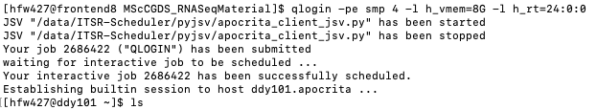
1. Setup qlogin in HPC
Start a qlogin session so that you can use an interactive node in HPC
$qlogin -pe smp 4 -l h_vmem=10G -l h_rt=24:0:0
(this qlogin example requests 4 cores of CPU, 8GB of RAM and runtime of 24 hours)

Slide 4
1*. Copy data from HPC teaching directory to scratch
cd /data/scratch/YOUR_ID/
cp –r /data/teaching/bci_teaching/RNASeq .
mkdir myRNASeq
cd myRNASeq
cp –r ../RNASeq/raw_FASTQs/* .
cp –r ../RNASeq/GRCh38.genome/ .
cp –r ../RNASeq/GRCh38.105.rsem.ref/ .
cp –r ../RNASeq/Homo_sapiens.GRCh38.105.gtf .
ls
Ready to continue :)

Slide 5

2. FASTQ file
Lets have a look into a fastq file
$zcat Ovcar4_2m_1.fastq.gz | head -n 4
Each entry in a FASTQ files consists of 4 lines:
A sequence identifier with information about the sequencing run and the cluster. The exact contents of this line vary by based on the BCL to FASTQ conversion software used.
The sequence (the base calls; A, C, T, G and N).
A separator, which is simply a plus (+) sign.
The base call quality scores. These are Phred +33 encoded, using ASCII characters to represent the numerical quality scores.
https://emea.support.illumina.com/bulletins/2016/04/fastq-files-explained.html

Slide 6

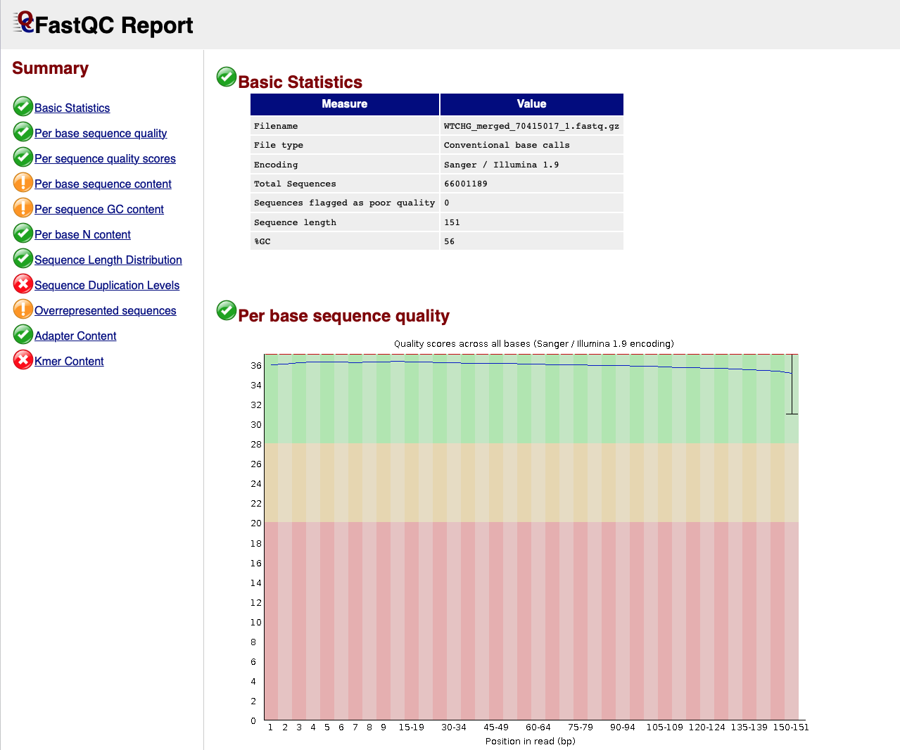
3. QC fastq file
FastQC provides a simple way to do some quality control checks on raw sequence data coming from high throughput sequencing pipelines.
$ module load fastqc
$fastqc Ovcar4_2m_1.fastq.gz
Example html
https://www.bioinformatics.babraham.ac.uk/projects/fastqc/

Slide 7
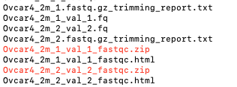
4. Quality and adapter trimming using trimgalore
Performing quality and adapter trimming using trimgalore. We can include FASTQC to be done once trimming is complete by adding the –fastqc_args parameter. We will be using the trimmed fq files for further analysis.
$module load trimgalore
$mkdir trimmed_FASTQs
$mkdir trimmed_fastQC
$trim_galore --paired --illumina --dont_gzip --fastqc_args "-o trimmed_fastQC" -o trimmed_FASTQs Ovcar4_2m_1.fastq.gz Ovcar4_2m_2.fastq.gz
https://www.bioinformatics.babraham.ac.uk/projects/trim_galore/

Slide 8
5. STAR alignment
Running STAR alignment for 150bp paired-end reads on GRCh38:
$module load star
$STAR --runThreadN 4 --genomeDir GRCh38.genome --sjdbGTFfile Homo_sapiens.GRCh38.105.gtf --sjdbOverhang 149 --outFilterType BySJout --outFilterMultimapNmax 20 --alignSJoverhangMin 8 --alignSJDBoverhangMin 1 --outFilterMismatchNmax 999 --outFilterMismatchNoverReadLmax 0.04 --alignIntronMin 20 --alignIntronMax 1000000 --alignMatesGapMax 1000000 --readFilesIn trimmed_FASTQs/Ovcar4_2m_1_val_1.fq trimmed_FASTQs/Ovcar4_2m_2_val_2.fq --outSAMtype BAM SortedByCoordinate --quantMode TranscriptomeSAM --outFileNamePrefix Ovcar4_2m_
The ---quantMode TranscriptomeSAM option activates the transcriptomic output
Parameters are ENCODE standard options
Note: The output of the alignment is SAM (which in other pipelines needs to be converted to bam using samtools). However, STAR allows SAM to BAM conversion while mapping, significantly reducing the time required to the sorting/conversion.
https://github.com/alexdobin/STAR/blob/master/doc/STARmanual.pdf

Slide 9
5. STAR alignment (Genome index)
Generating Genome Indices for STAR (we have done this step for you)
  This step generates genome indices using the genome FASTA file as input.
  Genome indices are required for all types of mapping jobs.
  This step needs to be performed only once for each genome assembly.
  The resulting files can be re-used for mapping different samples to the same genome
$mkdir -p ~/star/ GRCh38.genome
$cd ~/star/ GRCh38.genome
$wget ftp://ftp.ensembl.org/pub/release-105/fasta/homo_sapiens/dna/ Homo_sapiens.GRCh38.dna.primary_assembly.fa.gz
$gunzip Homo_sapiens.GRCh38.dna.primary_assembly.fa.gz
$cd ~/star/ GRCh38.genome
$STAR --runThreadN 5 --runMode genomeGenerate --genomeDir ./GRCh38.genome –genomeFastaFiles
./GRCh38.genome/Homo_sapiens.GRCh38.dna.primary_assembly.fa

Slide 10
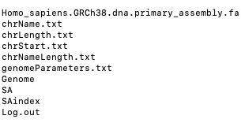
5. STAR alignment (Genome index output)

Slide 11
5. STAR alignment (Annotation file .gtf)
STAR can be run without the annotation file but it is strongly recommended to use it when available. Always best to match the source of FASTA file and the .gtf. For example, if you downloaded FASTA from Ensembl it is good practice to download the GTF from Ensembl too. Otherwise you may encounter incompatibilities between the two e.g. on the way chromosomes are named, it can be chr1, chr2 in some … or 1,2,3 etc. in other.
cd ~/star
wget ftp://ftp.ensembl.org/pub/release-105/gtf/homo_sapiens/Homo_sapiens.GRCh38.105.gtf.gz
gunzip Homo_sapiens.GRCh38.79.gtf.gz
Homo_sapiens.GRCh38.105.gtf

Slide 12

5. STAR alignment (OUTPUT)
STAR outputs bam files and various mapping metrics
This is the bam file in transcriptomic co-ordinates. It going to be used for the read counting step using rsem-count
This is the classic genomic bam file that can be used in other pipelines downstream eg htseq etc.
This can be used to evaluate mapping performance and quality of RNASeq (STAR manual for details)

Slide 13
6. Quantification of gene abundance using rsem (COMMAND)
rsem-calculate-expression
$module load rsem
$rsem-calculate-expression --bam --strandedness reverse --no-bam-output -p 2 --paired-end Ovcar4_2m_Aligned.toTranscriptome.out.bam ../GRCh38.105.rsem.ref/ref Ovcar4_2m_Quant
--paired-end –strandness reverse options are applicable to paired stranded RNA-seq data such as Illumina stranded Tru-seq protocol
-p 2 defines the number of threads used by RSEM
Refer to RSEM documentation for detailed description of RSEM parameters

Slide 14
6. Quantification of gene abundance using rsem (reference file)
To prepare the RSEM reference we need to run the following commands (We have run this step for you)
mkdir ~/ GRCh38.105.rsem.ref
rsem-prepare-reference --gtf ./Homo_sapiens.GRCh38.105.gtf ./GRCh38.genome ./GRCh38.105.rsem.ref/ref
Again, the reference is created once for a certain genome (FASTA) and annotation (GTF) and re-used to run multiple samples

Slide 15

6. Quantification of gene abundance using rsem (OUTPUT)
rsem-calculate-expression produces the following output files:
These contain the expression estimates at gene and isoform level. They are tab delimited files with the following columns:
gene_id, transcript_id(s), length, effective_length, expected_count, TPM, FPKM
A gene's 'length' and 'effective_length' are defined as the weighted average of its transcripts' lengths and effective lengths. A gene's abundance estimates are just the sum of its transcripts' abundance estimates. You can read in more detail on https://deweylab.github.io/RSEM/rsem-calculate-expression.html

Slide 16
6. Quantification of gene abundance using rsem (OUTPUT)
rsem-calculate-expression produces the following output files:
These contain the expression estimates at gene and isoform level. They are tab delimited files with the following columns:
gene_id, transcript_id(s), length, effective_length, expected_count, TPM, FPKM
A gene's 'length' and 'effective_length' are defined as the weighted average of its transcripts' lengths and effective lengths. A gene's abundance estimates are just the sum of its transcripts' abundance estimates. You can read in more detail on https://deweylab.github.io/RSEM/rsem-calculate-expression.html
These are the columns that we need to use for the differential expression analysis

Slide 17
6. Quantification of gene abundance using rsem (OUTPUT)
rsem-calculate-expression produces the following output files:
These contain the expression estimates at gene and isoform level. They are tab delimited files with the following columns:
gene_id, transcript_id(s), length, effective_length, expected_count, TPM, FPKM
A gene's 'length' and 'effective_length' are defined as the weighted average of its transcripts' lengths and effective lengths. A gene's abundance estimates are just the sum of its transcripts' abundance estimates. You can read in more detail on https://deweylab.github.io/RSEM/rsem-calculate-expression.html
These are normalized counts
TPM = transcripts per million
FPKM = fragments per kilobase of transcript per million fragments mapped

Slide 18
7. Automation
Once we have optimized the tools and parameters using a single sample (in an interactive session), we can write a script to run multiple samples.
To do that we need to be flexible with the variables. For example, we can refer to components of the command as numbered variables within the actual script:
    $1 = input.fastq
    $2 = input.gtf
    $3 = output.bam
We also need to create “array jobs” and submit them through qsub to HPC. You can read more details about this task on https://docs.hpc.qmul.ac.uk/using/arrays/

Slide 19
7. Example array job for FASTQC of all fastq files
#!/bin/sh
#$ -cwd
#$ -pe smp 1 # Request 1 CPU core
#$ -l h_rt=200:0:0
#$ -l h_vmem=23G
#$ -t 1-10
#$ -tc 5
module load java/1.8.0_152-oracle
module load fastqc/0.11.5
fastq_dir=/data/RNASeq_exp/FASTQs
results_dir=/data/RNASeq_exp/results
mkdir -p ${results_dir}/fastQC
fastq=$(sed -n "${SGE_TASK_ID}p" ./all_raw_fastqs_list)
fastqc ${fastq_dir}/${fastq} -o ${results_dir}/fastQC
You can find out more about array jobs here https://docs.hpc.qmul.ac.uk/using/arrays/

Slide 20
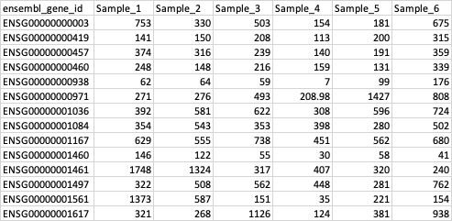
8. How to create a counts matrix of all the samples
This is what we are ultimately aiming for; a matrix of the rsem estimated_counts that has gene ids in rows and samples in columns.
How could we extract the expected_counts column of the rsem result tab file and make a matrix like the above containing of the expected counts across all the samples of an RNASeq experiment?
This requires a bit of data wrangling, there are many ways you could do it, you can find one way to do it in the last chunk of the R markdown file

Slide 21
References
https://emea.support.illumina.com/bulletins/2016/04/fastq-files-explained.html
https://www.bioinformatics.babraham.ac.uk/projects/fastqc/
Dobin et al. Mapping RNA-seq Reads with STAR. Curr Protoc Bioinformatics. 2015 Sep 3;51:11.14.1-11.14.19.

